Slide 1
Presentation of IIT
Date:2076/08/21
Submitted By : Submitted To:
Name : Sanam Tamang Name : Uma Dhungel
Roll No :14 Teacher of IIT
Name :Sunil Mainali
Roll No:20
Class : first Semester(BICT)
Subject : Introduction to Information Technology(IIT)

Slide 2
Central Processing Unit
The central processing unit is the main part of computer. It is also known as a brain of computer .It interprets and executes program instructions .It controls all the function of computer .In the short form it is also called CPU .CPUs are generally desirable because they allow computers to complete task quickly .It is small microprocessor chip which is joined on motherboard.

Slide 3
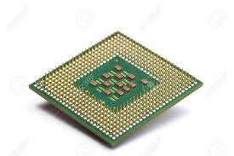
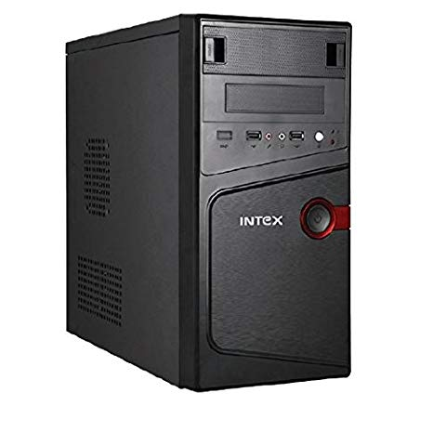
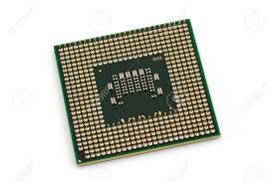
Pictures of CPU

Slide 4
Units of CPU
Arithmetic and logic unit
Control unit
Memory unit

Slide 9
Flow chart of CPU Units
CPU
ALU
Control Unit
Memory Unit
RAM
ROM
S-RAM
PROM
D-RAM
EPROM
Figure of CPU Units
EEPROM

Slide 10
END OF THE PRESENTATION

